Slide 1
Chương 7: Tác động của CNTT đến các vấn đề xã hội và kinh tế
GV: Nguyễn Thị Hạnh

Slide 2

Impact of IT on Communication

Slide 3
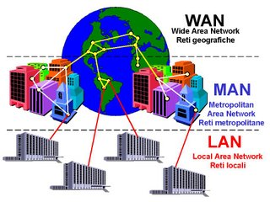
Impact of IT on Communication
Networks: Lans or WANs

Slide 4
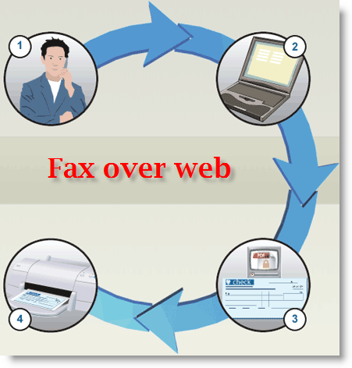
Impact of IT on Communication
Fax

Slide 5

Impact of IT on Communication
Mobile Telephone

Slide 6

Impact of IT on Communication
WWW: World Wide Web – Collection of pages with links to other pages

Slide 7

Impact of IT on Communication
E-mail:

Slide 8
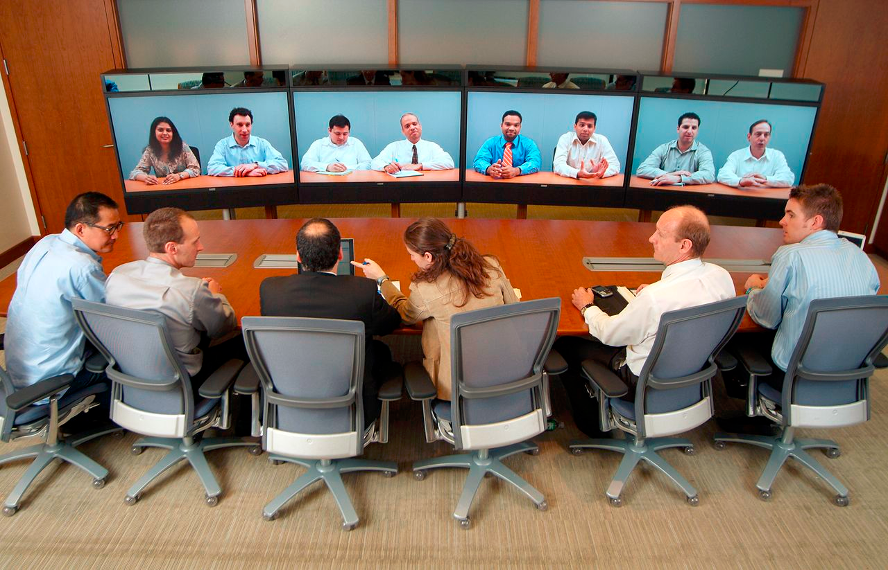
Impact of IT on Communication
Video Conferencing

Slide 9

Impact of IT on Bussines
Barcode

Slide 10

Impact of IT on Bussines
E-Commerce

Slide 11
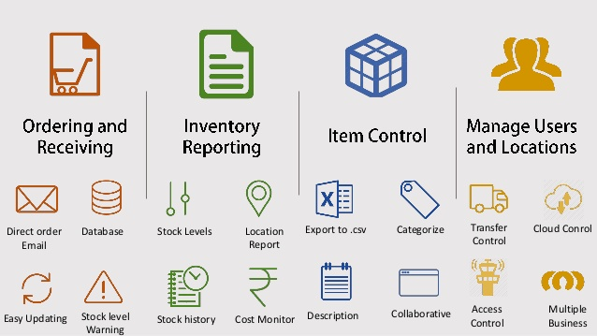
Impact of IT on Bussines
Stock Control

Slide 12
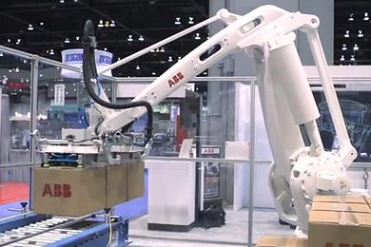
Impact of IT on Bussines
Robots: Used on production lines

Slide 13

Impact of IT on Bussines
Computer Aidied Design

Slide 14
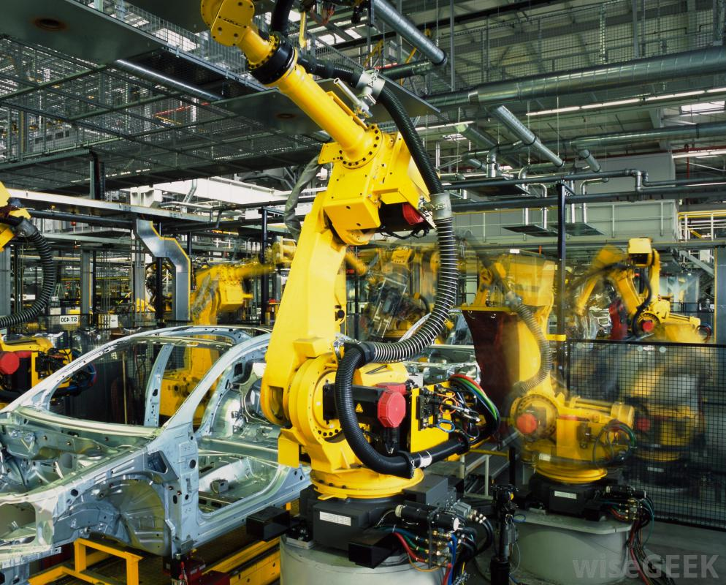
Impact of IT on Bussines
computer aided manufacture

Slide 15

Impact of IT on Bussines
Smart Cards

Slide 16
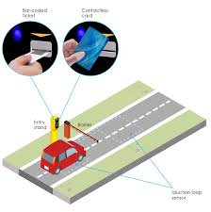
Impact of IT on Bussines
Automatized Payments

Slide 17
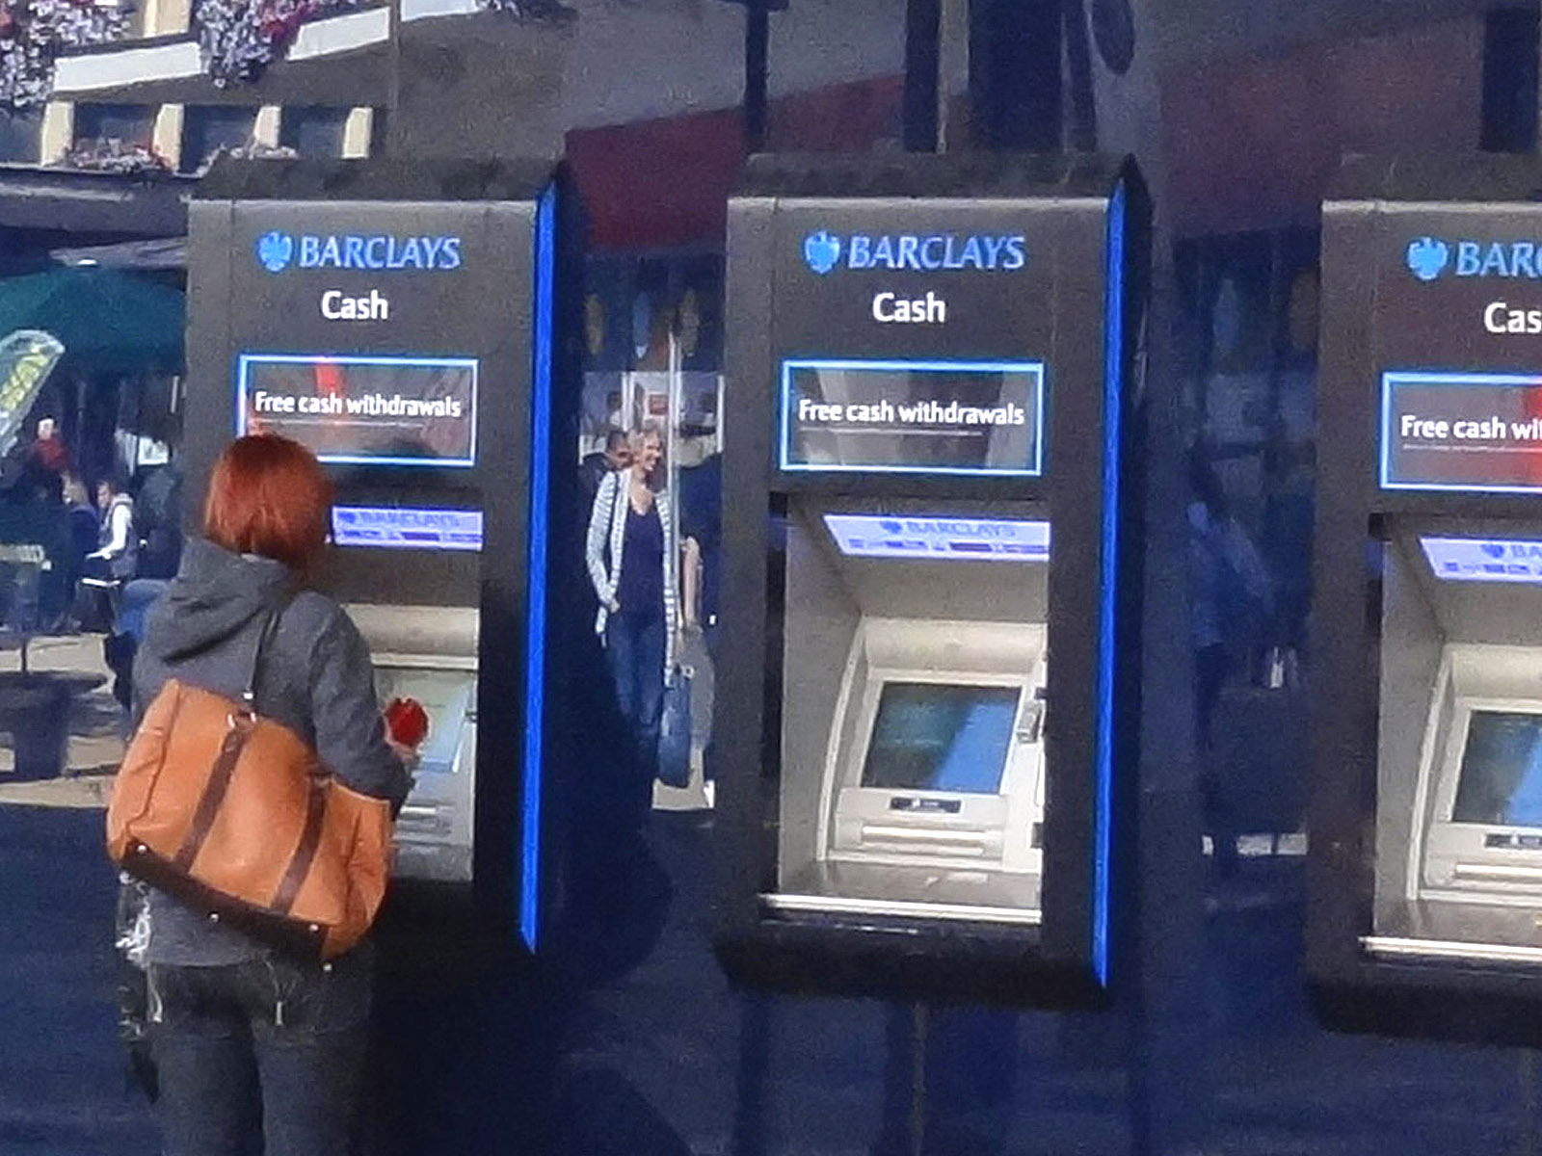
Impact of IT on Bussines
Cash Machines

Slide 18
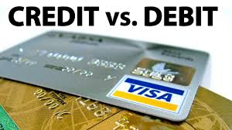
Impact of IT on Bussines
Credit/ Debit Cards

Slide 19
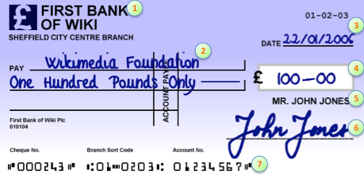
Impact of IT on Bussines
Cheque Processing

Slide 20

Impact of IT on Bussines
Home Banking

Slide 21

Tội phạm công nghệ cao

Slide 22

Tội phạm

